Slide 1
Occlusion Handling in Behavior Planning using Imitation Learning
Janaranjani Palaniswamy
Supervisor: Stoll Martin
Monthly Status Update - 18.2.2022

Slide 2
Month Forecast
Complete the IDM adaptation to handle the occlusion zones.
Generate new training data with the new expert.
Training and evaluation of the policy with new dataset.
Visibility layer to data
Add-ons
Dynamic occlusion zones
Change occlusion and trigger areas to evaluate the limited visibility IDM

Slide 3
Progress
Completed the IDM adaptations to handle risk of occlusions.
Spawn vehicles into occlusion zones.
IDM hallucinates about the hidden vehicles and check priorities accordingly.
Implemented dynamic occlusion zones – To avoid unwanted filtering
Defined fixed trigger zone based on ego positions.
Adapted the object filter to turn on relevant occlusions if ego is inside the trigger zone.
Detailed evaluation of IDM.
Baseline IDM
IDM with limited visibility (no idea about vehicles inside occlusion zones)
New IDM with full visibility (visibility of vehicles inside occlusion zones)

Slide 4
Add-on
Progress
Enhanced the trigger zone area.
Enhanced occlusion zone area (ego slows down in trigger zone).
Logged the IDM peformances and defined new metrics.

Slide 5
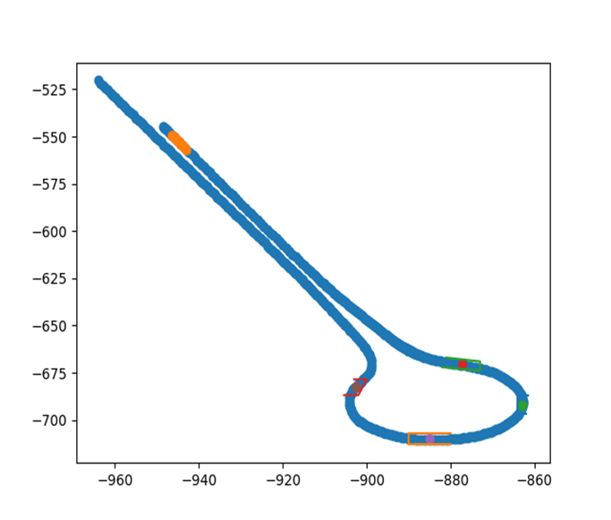
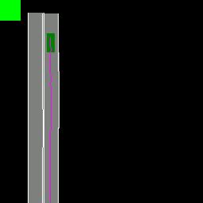
Observations – Problem with Fixed Occlusions
Progress
As the occlusions are fixed, the vehicles in environment are filtered in all the zones irrespective of ego’s pathway.
Fixed-occlusion zones
New-IDM

Slide 6
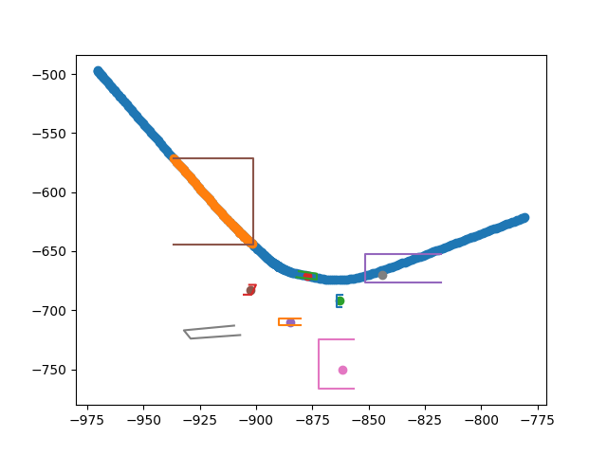
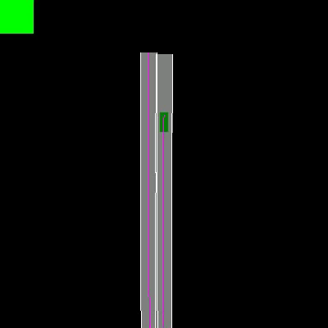
Observations- Dynamic Occlusions
Progress
Occlusion zone is activated based on ego position.
Occlusion and trigger zones
Dynamic occlusions New IDM

Slide 7
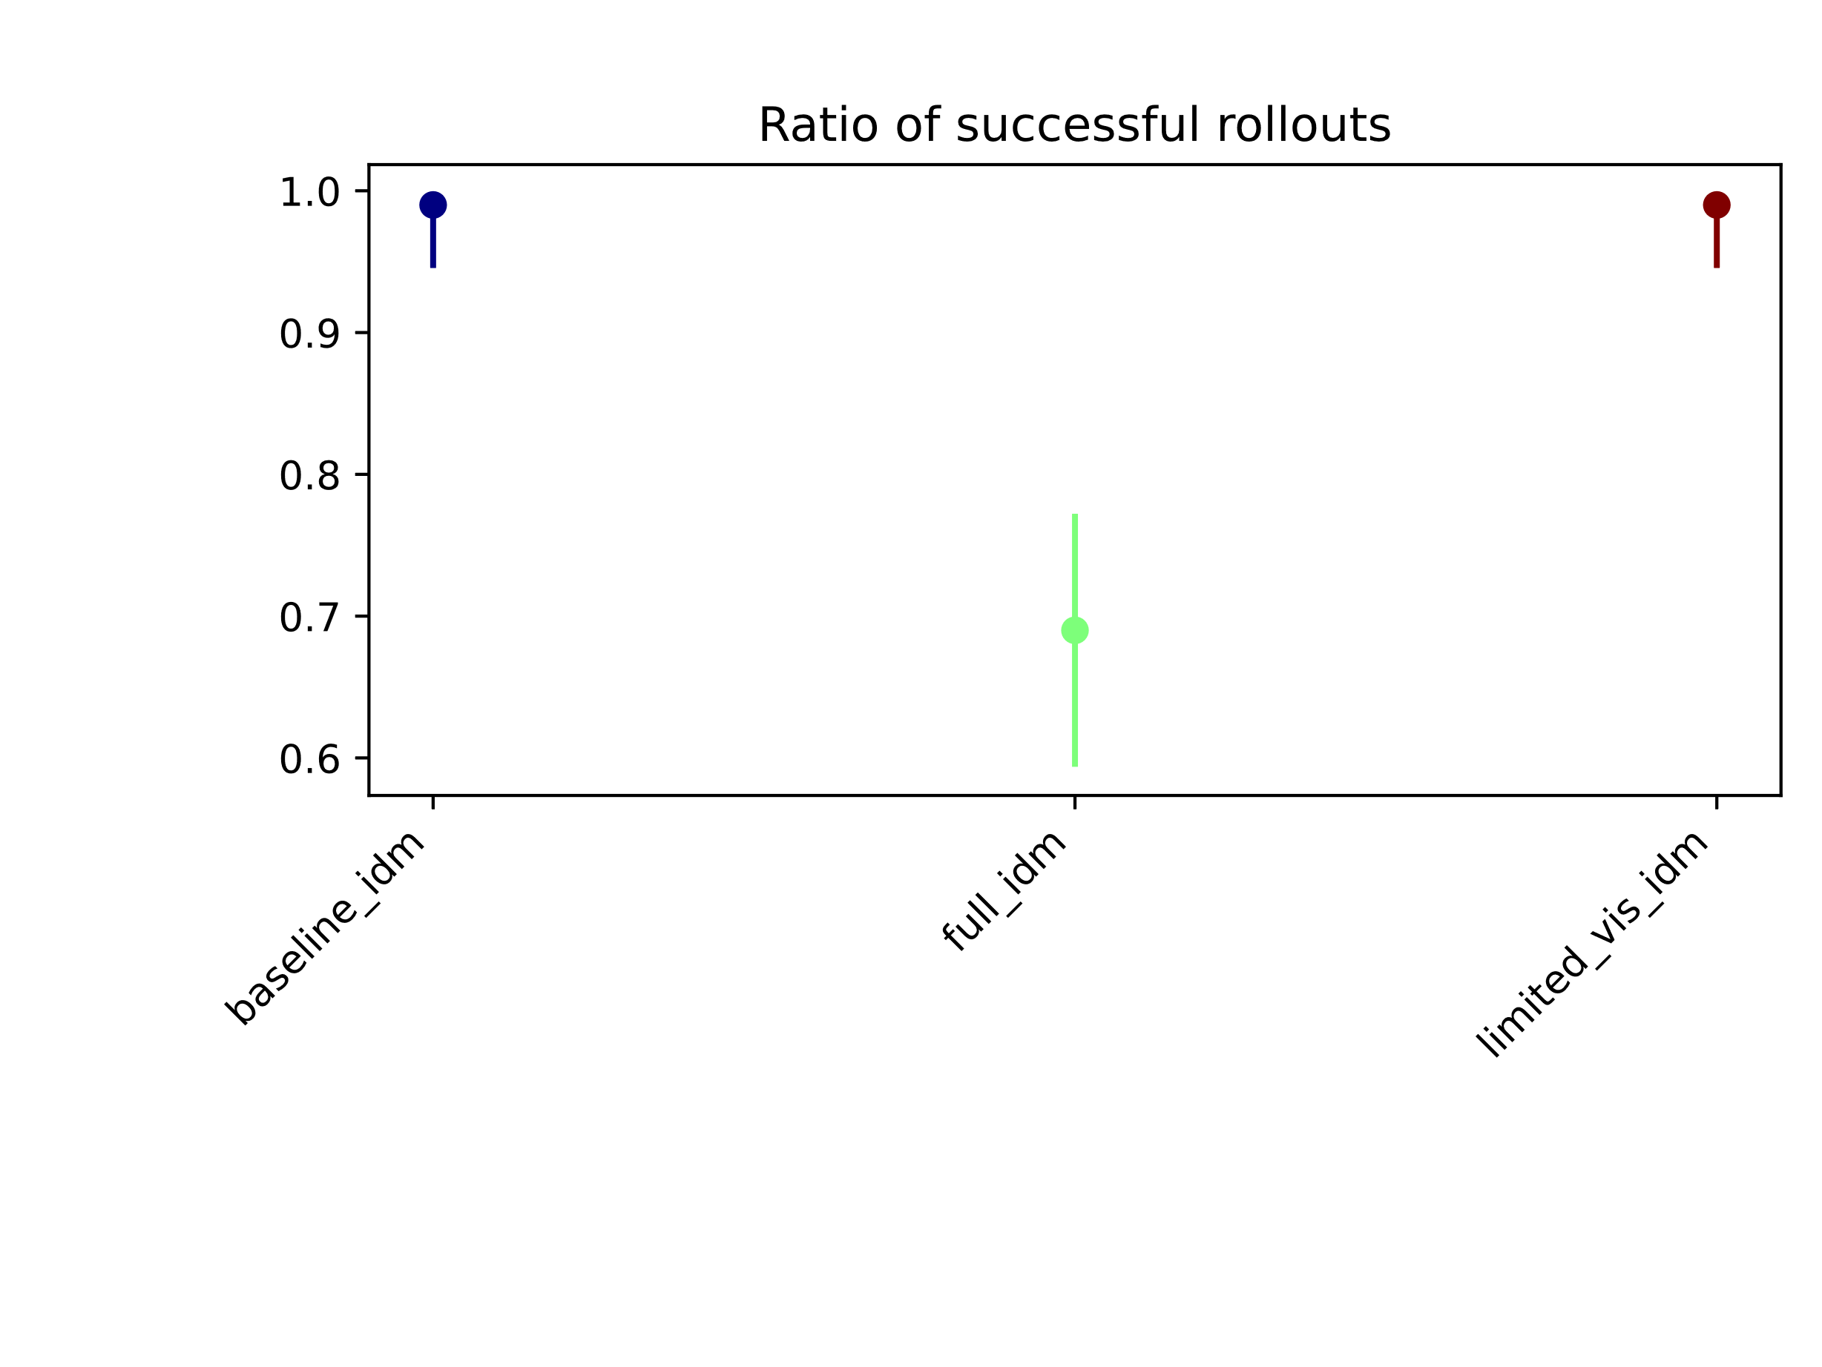
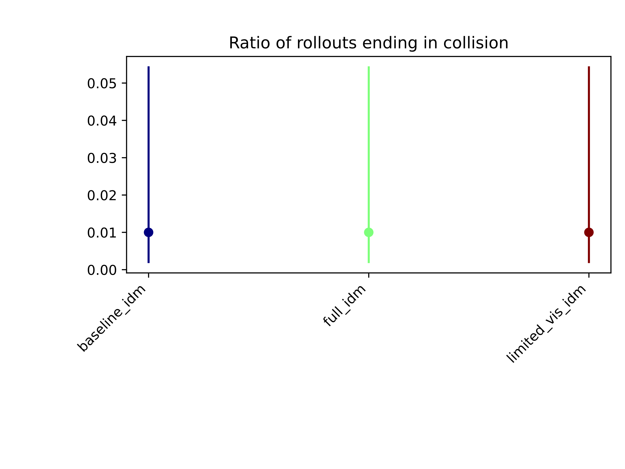
Observations - Evaluation
Progress

Slide 8
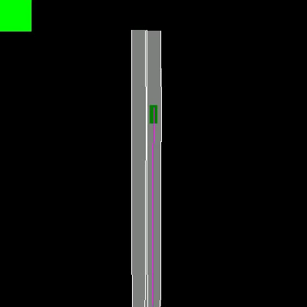
Observation –Comparison
Progress
Baseline and Limited visibility model has different rate of breakdown.
Baseline
Limited_visibility_IDM

Slide 9
Observation –Comparison
Progress
Parameter | Baseline | Limited_visibility_IDM | Full-idm
Stopping position | [-857.0432, -681.5541] | [-857.5291, -681.9789]
Rate of breakdown (rate at which velo decreases after trig zone) | 0.2 m/s | 0.4 m/s
Rate of deceleration (min speed – speed before 5 steps)/delta_t | 5.1042 m/s^2 | 2.737 m/s^2 | 3.15865*(10^-3) m/s^2
The lim_vis model starts breaking later and at faster rate. (starting breaking velocity is
less than baseline model)

Slide 10
Next Monthly Forecast Plan
Further Steps
KPI definition
Refining new model if required.
Generate new dataset and train the policy
Added visibility layer to the grid data
Hyperparameter optimization
Ablation Study ( two datsets and two policy models)
Enhance policy model if required.

